Slide 1

EU Cohesion Policy support to business on islands
INSULEUR – ESIN - EESC Brussels 5 April 2019
By Eleftherios Stavropoulos
DG REGIO

Slide 2


Slide 3
Cohesion Policy is an investment policy that aims to reinforce economic, social and territorial cohesion in all regions based on strong multi-level governance arrangements in partnership with regions and their citizens at its core.
In 2014-2020 instead of developing compensation schemes for handicaps, we chose to invest in all territories (islands included) and help to develop their comparative and competitive advantages. Small and medium-sized enterprises are vital for the EU's economy, accounting for more than 99% of European businesses and two thirds of private sector jobs. The European Structural and Investment Funds offer more than €450 billion to Member States in 2014-2020 to finance investments for enhancing jobs and growth.

Slide 4
Cohesion Policy in 2014-2020. Investments in SMEs
Improving the competitiveness of SMEs is one of the 11 thematic objectives for Cohesion Policy in 2014-2020. Additional investments in SMEs will also be made under other thematic objectives, particularly research and innovation, the low-carbon economy and information and communication technologies. €57 billion or around 20% of funding from the European Regional Development Fund (ERDF) will be dedicated explicitly to SMEs. The increased use of financial instruments mobilising additional EU, national and regional funds during the 2014-2020 funding period is also expected to benefit SMEs.

Slide 5
Thematic Objective: 3 SME competitiveness by Country

Slide 6
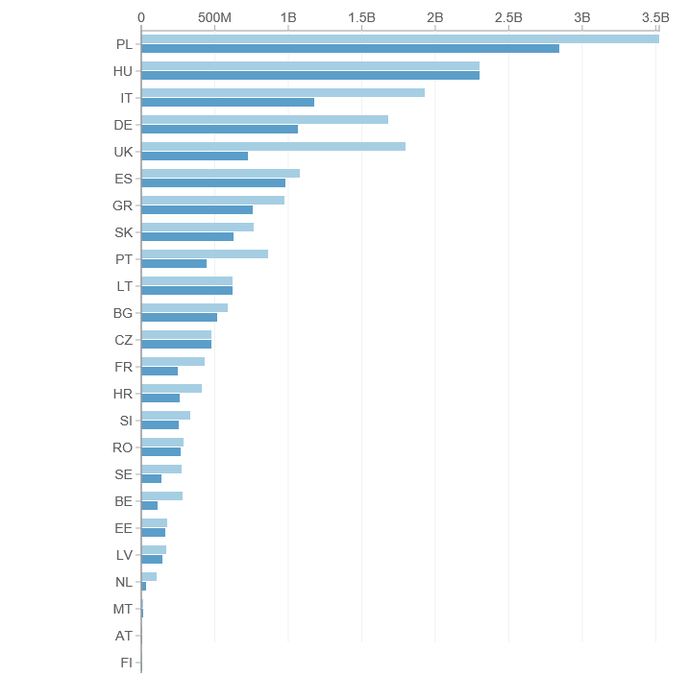
ESIF 2014-2020: EUR volume of Financial Instruments approved by MS

Slide 8
Investments from EU Regional Policy will help SMEs
Access finance for investments through grants, loans, loan guarantees, venture capital, etc.
Benefit from targeted business support, e.g. know-how and advice, information and networking opportunities, cross-border partnerships.
Improve their access to global markets and international value chains
Exploit new sources of growth: green economy, sustainable tourism, health and social services including the “silver economy” and cultural and creative industries
Invest in human capital and in organisations providing practice-oriented vocational education and training
Forge valuable links with research centres and universities to promote innovation

Slide 9
Easier access to Regional Policy Funds in 2014-20 for SMES
online reporting of how the Funds are used
clearer eligibility rules
more targeted and less frequent audits for small operations
wider scope and simplification of the set-up and access to financial instruments

Slide 10
Results of 2007-13 Prospects for 2014-2020
Increased investment in SMEs in 2014-2020 will build on the achievements of EU Cohesion Policy during the 2007-2013 funding period:
More than 95,000 start-ups supported
More than 300,000 jobs created in SMEs

Slide 11
Article 121 of the Common Provisions Regulation also mentions that the co-financing rate from the funds to a priority axis may be adjusted to take account of, amongst others, island Member States eligible under the Cohesion Fund, and other islands, except those on which the capital of a Member State is situated, or which have a fixed link to the mainland.

Slide 12
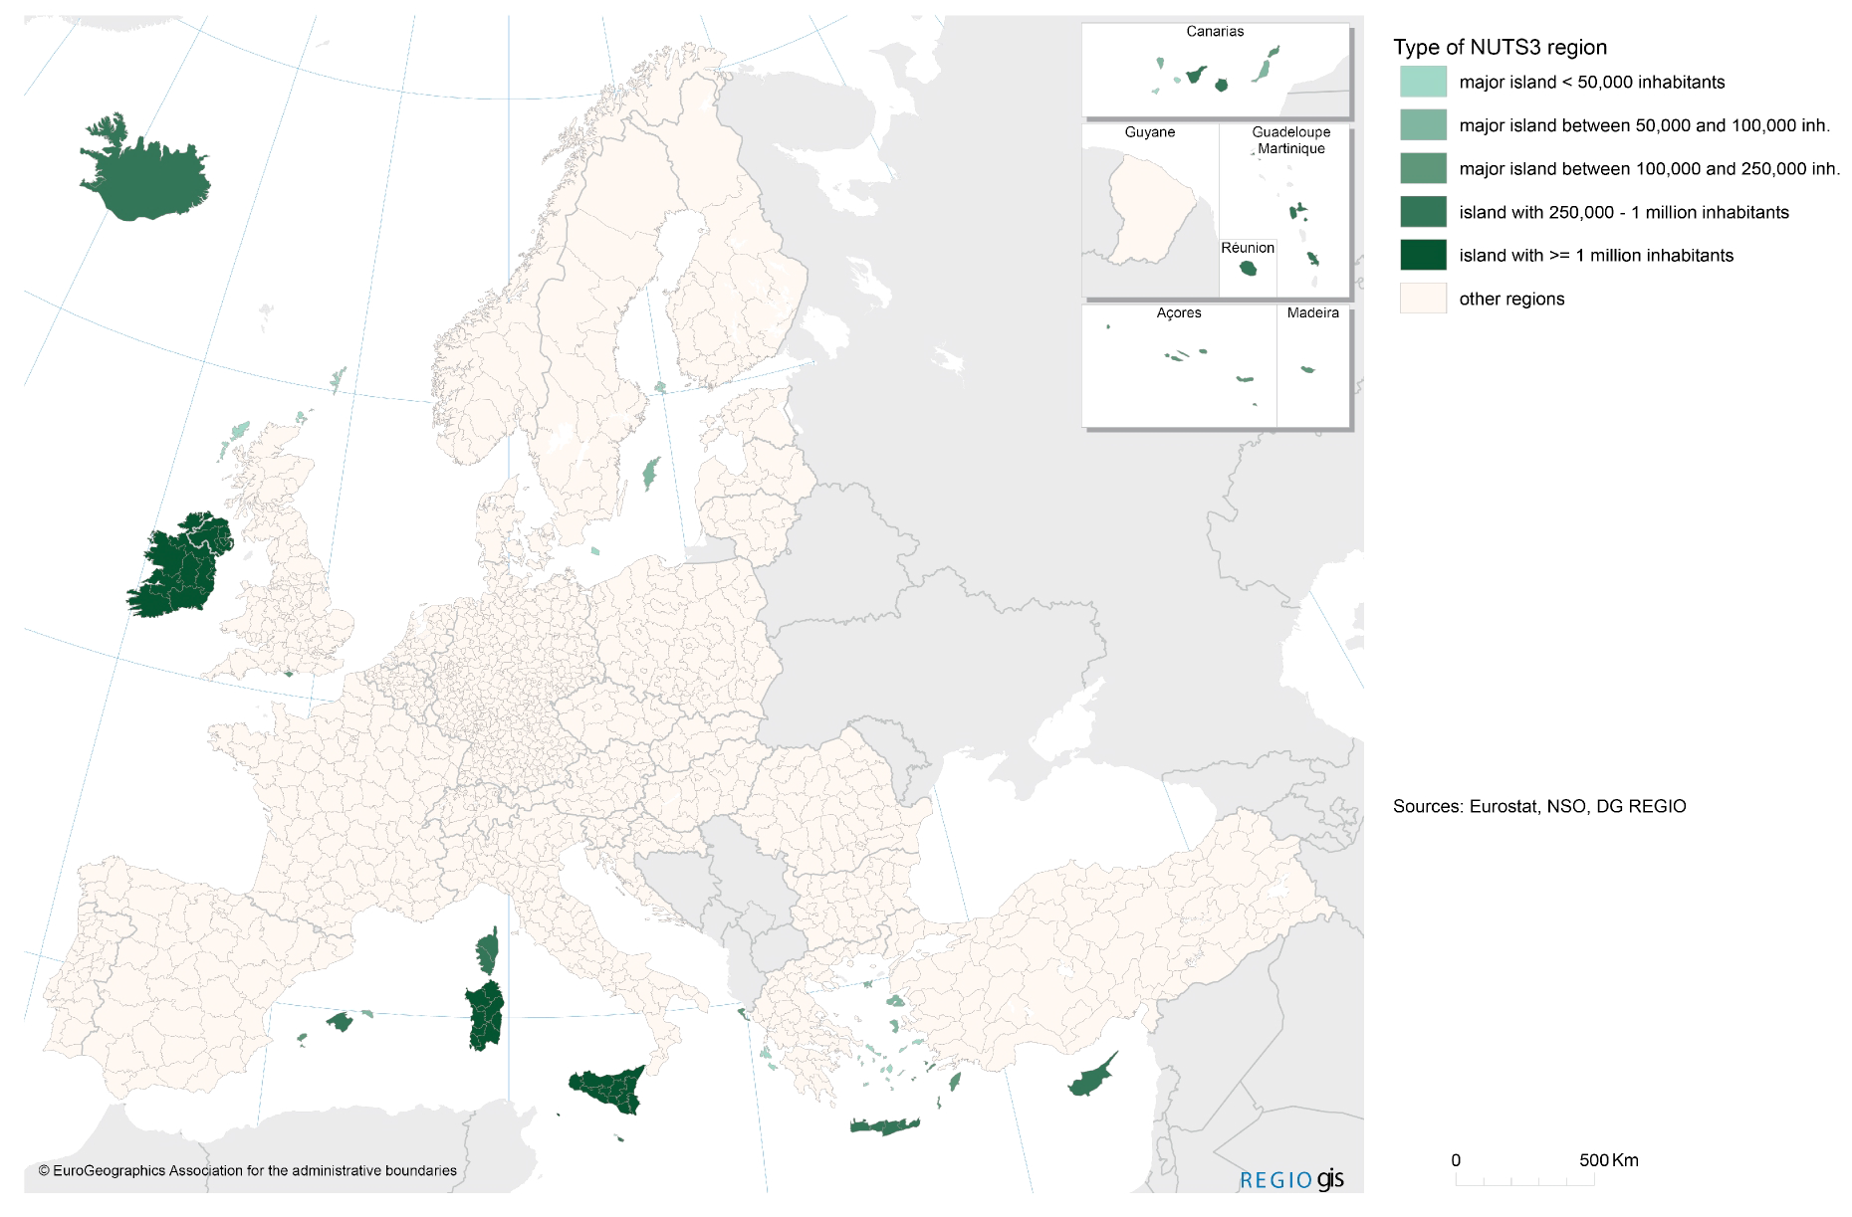
SMEs on islands face different challenges and have different opportunities

Slide 13


Slide 14




New opportunities for SMEs on islands
Islands face considerable challenges. However, there more opportunities for islands in renewable energy, production of pharmaceutical products from local plants, quality food and spirit products of origin, aqua farming, sea technology etc. Take advantage of their strong brand, put quality on top, avoid mass tourism and focus on green tourism, on welenss and exclusivity etc.

Slide 15
New opportunities for SMEs on islands
Smart Specialisation Strategies and the entrepreneurial discovery shows that there is a lot of potential in islands and not just tourism and residential services

Slide 16
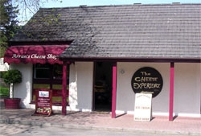
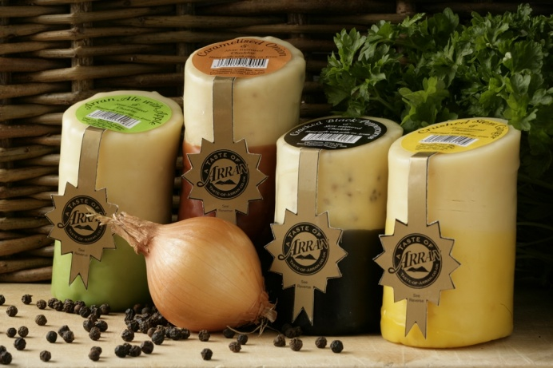
Island Cheese Company
The Isle of Arran in Scotland being 'Clean and Green' seemed a natural place to establish the, and so this family business was formed over 15 years ago in the Home Farm of Brodick Castle. Initially established to supply our delicious flavoured cheddars to a local and tourist market through our own shop, it soon became apparent that supply was required further afield. The demand from visitors who had returned home and wanted our products sent to them instigated our mail order service. Nowadays we sell at 25 farmer's markets each month and supply a number of outlets throughout the UK .

Slide 17
Cultural Tourism
Scattery Island/Kilrush, Clare – Ireland
Winner in the Cultural Tourism category of the EDEN - European Destinations of Excellence
Located just 50 minutes from Shannon Airport, Scattery Island is a small monastic island located just 2 kilometres off the coast of West Clare on the Wild Atlantic Way. Although many tourist sites market themselves as being a 'hidden gem', a trip to Scattery really is a unique visitor experience.

Slide 18


Gastronomical Tourism
The Region of the South Aegean European Region of Gastronomy 2019 is one of the thirteen regions of Greece. It consists of the Cyclades and Dodecanese island groups in the central and south-eastern Aegean Archipelagos. With a population of 308.610 inhabitants and numbering more than 50 inhabited islands, each one with its own peculiarity, historical background and culture, its unique geophysical environment, gastronomic identity and local products, the South Aegean Region is a “paradise on Earth”.

Slide 19
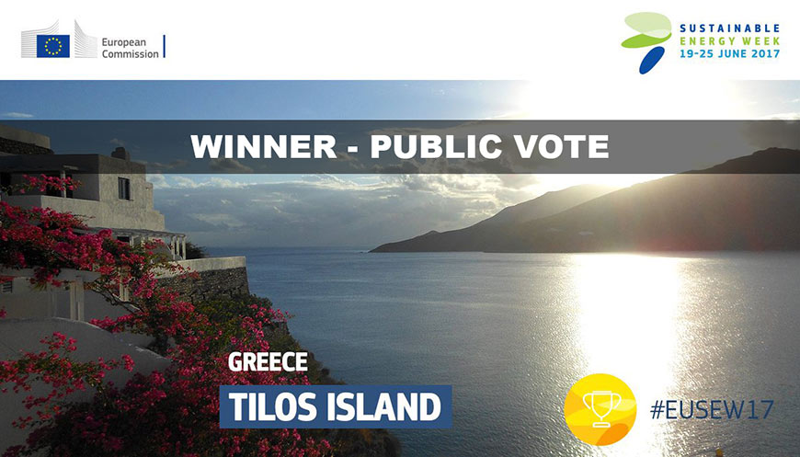
Pioneering project aiming to achieve clean energy autonomy for remote islands wins two EU awards

Slide 20

DG REGIO supports ENER important initiative on clean energy islands, allowing to make value of the potential of islands in renewable energy sources and limit the effects of their constraints, instead of a separate fund for islands.

Slide 21

Big multinationals like Hitachi are looking for islands to test new technologies. Island SMEs can be providers, co-producers etc

Slide 22

Innovation Policies for Sustainable European Islands Insular regions in this project want to address the opportunities of diversification of their economies by improving their innovation policies. The project focus is to investigate and improve public policy measures in order to turn the islands into innovation "test-beds": islands as innovation-promoting, experimental "probing and learning" environment which can keep and attract young, innovative and entrepreneurial people and activities to the islands. This will be done through policy improvement, learning sessions, action plan development, good practice identification and sharing and active work on the islands with involvement of regional stakeholder groups. The project will collect and disseminate the knowledge gained in good practice directory and innovation guide for island regions.

Slide 23
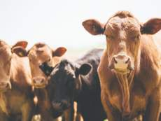
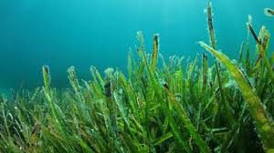

Innovation is the solution
+
=
Seaweed as a Superfood
The benefits of Seaweed: Health Products and medication

Slide 24

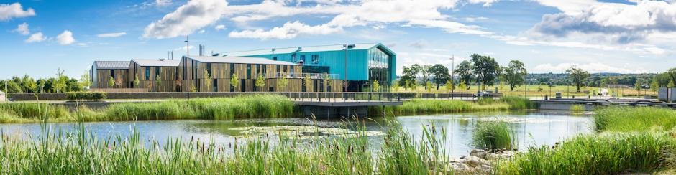
Use ERDF for mechanisms to support island SMEs

Slide 25
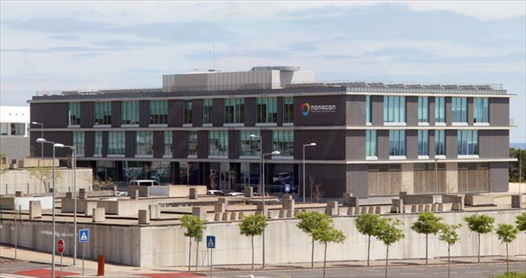
Creating an ecosystem to support innovation
Nonagon (Science & Technology Park) Azores

Slide 26
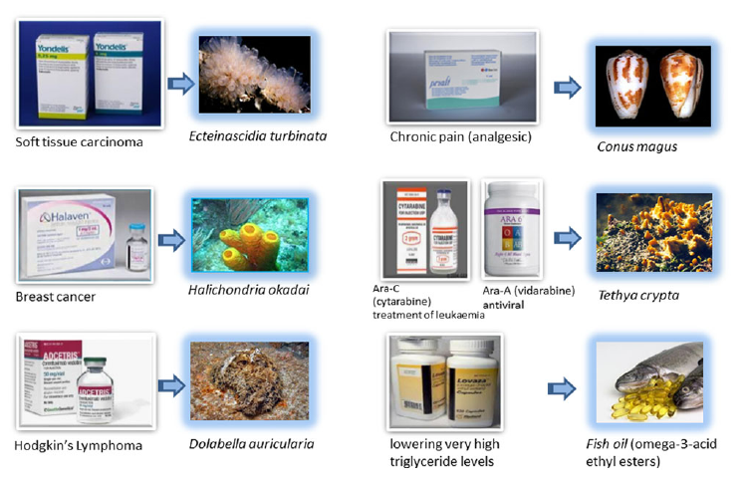
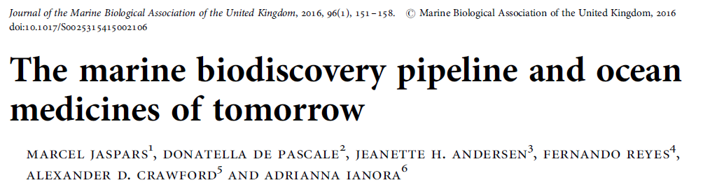
Opportunities from biodiversity of islands

Slide 27
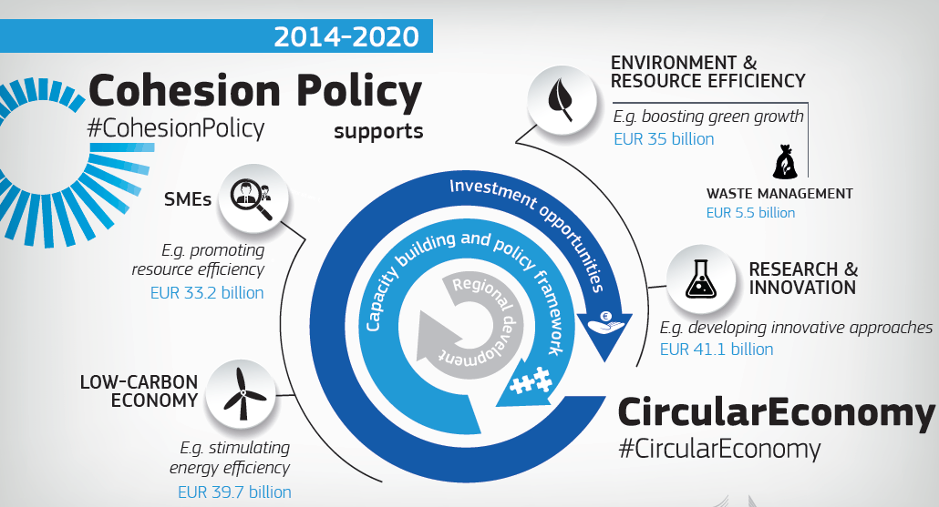
New opportunities for SMEs on islands

Slide 28
The islanders of Bute love the beer made by Bute Brew Co which is one of the few in Scotland who are using unsold loaves of bread donated from the local Co-op store. The island-based brewery recently launched its own 5.1% alcohol craft beer named ‘Thoroughbread,’
The initial set up and production of ThoroughBread beer was made possible by ERDF-funded investment from Zero Waste Scotland.

Slide 29
How to make circular economy in islands a reality?
• EU Policy: e.g. 2018 Circular economy package • EU Funds: e.g. Cohesion Policy 2014-2020: about EUR 150 billion are allocated to objectives with a direct relevance to the circular economy, including EUR 5.5 billion focused on waste management
• EU cooperation frameworks: e.g. EU Strategy for the Adriatic and Ionian Region can help to further strengthen cooperation and to further mobilize funding sources for the development of common circular economy projects

Slide 30

European Fund for Strategic Investments
Island projects could be bundled together into bigger packages/umbrella projects. The European Investment Advisory Hub can provide technical assistance.
In addition to the funds for Technical Assistance available under the Operational Programmes, the European Commission has furthermore provided for advisory and support mechanisms that could be used: for example the European Investment Advisory Hub, FI-Compass, Helena, REGIO Technical Assistance and Information Exchange instrument (TAIEX) Peer to Peer.
Notes:
A number of island projects have already benefitted from European Fund for Strategic Investments support (for example multi-sector investments in French outermost regions, bus transit systems in Gran Canaria).

Slide 31
Easier access to funding for island SMEs
FI was set up for Bornholm island in Denmark;
FI managed by Almi Invest in Sweden

Slide 32


Slide 33
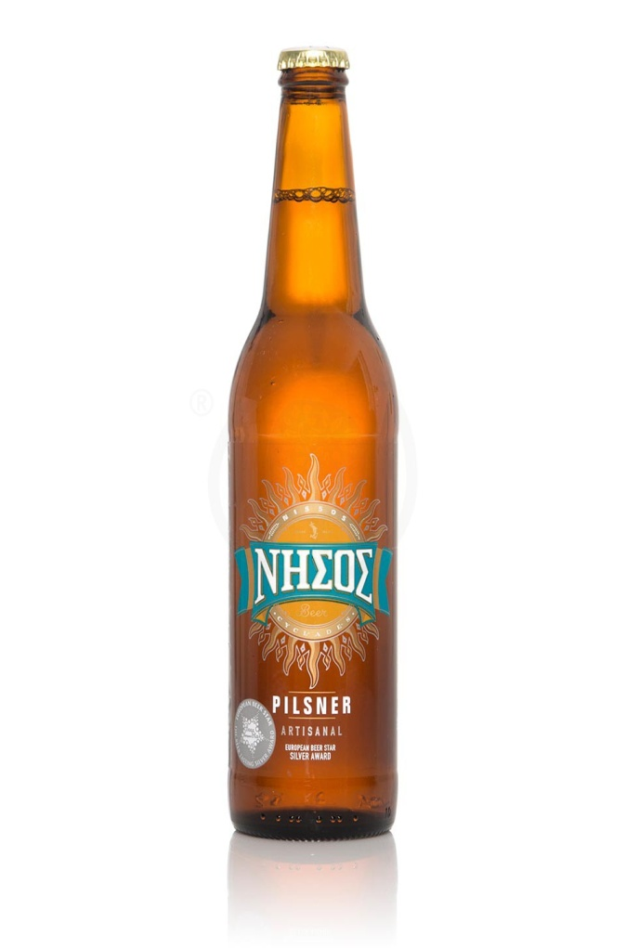
And if you still have questions
Silver European Beer Star
Island of Tinos Greece

Slide 34
Thank you for your attention
Notes:
34

