Slide 1

Access to Finance for SMEs
Mr Joseph Borg (President of the Gozo Business Chamber)
Public Hearing: Are European Policies suitable to help doing business on Islands?
5TH April 2018

Slide 2

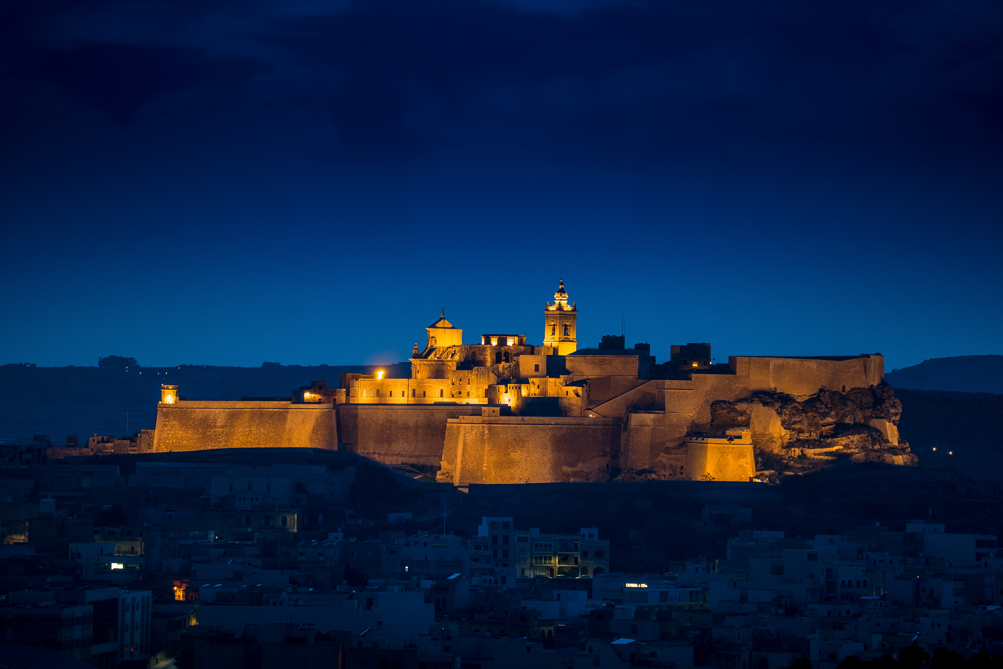



The Commitment of the European Commission
Photo: Ross Magri Gozo Citadel courtesy of www.visitgozo.com

Slide 3
The European Dimension
The European Commission helps small and medium-sized enterprises (SMEs) to overcome weaknesses in the financial markets by working with various financial institutions to provide them with funding.
This is done using EU financial instruments to increase the opportunities for small businesses to obtain finance from banks, through guarantee providers, and via venture capital funds.
  “SMEs often face significant difficulties in obtaining the financing they need in order to grow and innovate”.
Source : Communication from the European Commission on an ‘Action Plan to improve access to finance for SMEs’ (2011)

Slide 4

Access to Finance for SMEs

Slide 5
Access to Finance for SMEs
“Access to finance is a critical component for the development of firms, since a firm that cannot respond to an investment opportunity loses out on raising its income. Indeed, it is especially crucial for SMEs, whose financial needs differ significantly from those of large enterprises.”
Source: Sandra Zerafa, Access to finance for firms in Malta: Estimating the impact of reduced credit. Policy Note Central Bank of Malta (July 2017) (on-line) : https://www.centralbankmalta.org/file.aspx?f=61637

Slide 6

The Situation of SMEs on islands

Slide 7
Difficulties of SMEs on islands
Micro enterprises are the backbone of the business network in islands such as Malta and Gozo.
SMEs on islands face added costs and difficulties.
Lack of information (e.g. information sessions on islands).
Malta as an island faces added difficulties. The difficulties faced by businesses in Gozo (the second largest island) are event greater: double insularity.
Difficulties faced by enterprises in Gozo: lack of infrastructure and added transportation costs.

Slide 8


Access to Finance for SMEs in Malta

Slide 9
Access to Finance for SMEs in Malta
Maltese entrepreneurs tend to prefer to go for debt type of financing rather than equity, as they prefer to retain control of their organisation (Peter James Sant, 2014)
“SMEs in Malta continued to attach heavier reliance on bank financing when compared with their EU counterparts” (Sandra Zerafa, 2017)
Financial Instruments specifically targeted to SMEs focusing principally on interest rate reduction, and reduced collateral obligation.
The Malta Development Bank also caters for SMEs which would otherwise not be accommodated by private sector intermediaries.
Source: NSO (2017)

Slide 10
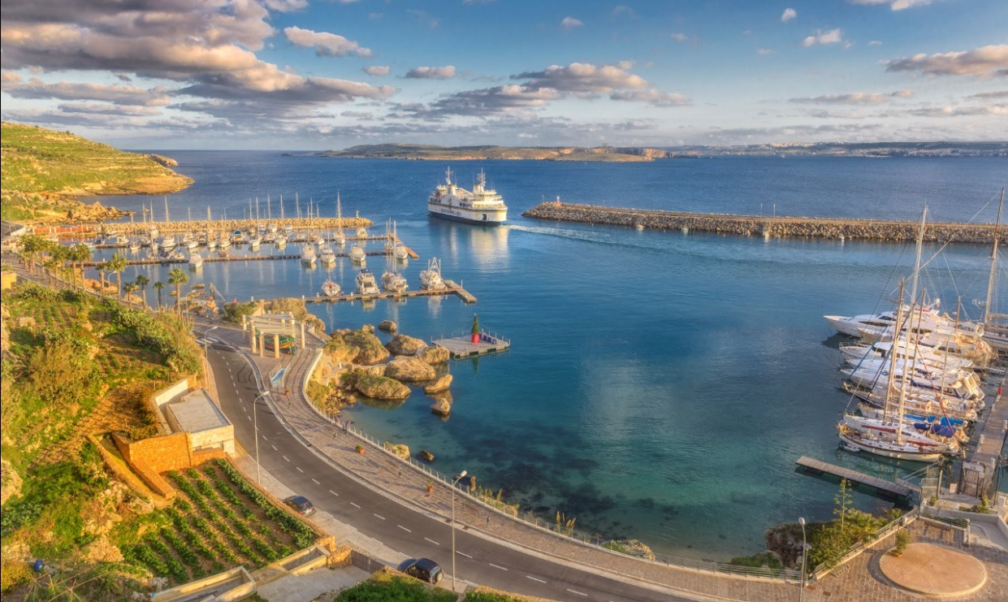
The Specific Reality in islands such as Gozo
Photo: Mgarr harbour in Gozo, Joseph Caruana courtesy www.visitgozo.com

Slide 11
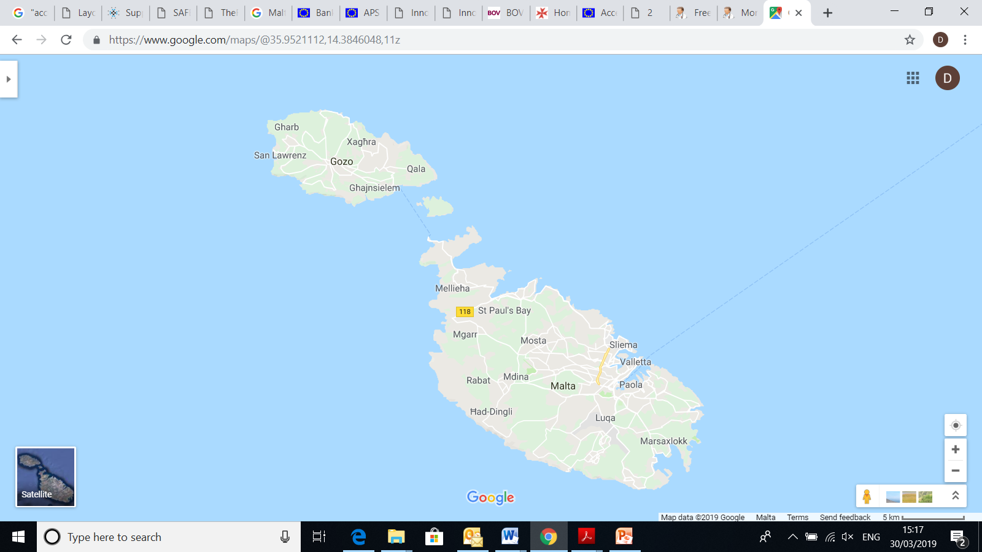
Malta and Gozo

Slide 12
The Specific Reality in Islands such as Gozo
The Government acknowledges Gozo’s difficulties and engages in action that aim to achieve a more equitable situation between the two islands e.g. ring fencing of 10% of EU funds to Gozo, increased thresholds for particular schemes when an enterprise is established in Gozo, and aid provided under the deminimis framework to neutralise transportation costs between the two islands.
Parameters of state aid framework particularly the deminimis framework applies nationwide.
Islands such as Gozo will always remain at a disadvantage as aid being provided to neutralise added costs will decrease the possibility of other funds under the deminimis framework decreasing the competitiveness of Gozitan based enterprises.

Slide 13

Strategic Direction

Slide 14

Where do we want to go?
“SMEs will be a source for growth and jobs in Europe only if their access to finance is improved” [Communication from the European Commission on an ‘Action Plan to improve access to finance for SMEs’ (2011), p. 14 ]
Access to finance for SMEs based on islands needs to be facilitated even further if SMEs based on islands are to be a catalyst for positive change for island economies.
Tailor made financing packages for island based SMEs.
Deminimis thresholds for islands needs to be revised upwards.

Slide 15
Thank you

