Slide 1
VAT IN EUROPEAN ISLANDS
George Assonitis
Advisor-Union of Hellenic Chambers
Member-Technical Committee INSULEUR

Slide 2
European taxation policy and VAT in Islands
a general tax that applies, in principle, to all commercial activities involving the production and distribution of goods and the provision of services
a consumption tax because it is borne ultimately by the final consumer
charged as a percentage of price
collected fractionally
paid to the revenue authorities by the seller of the goods

Slide 3
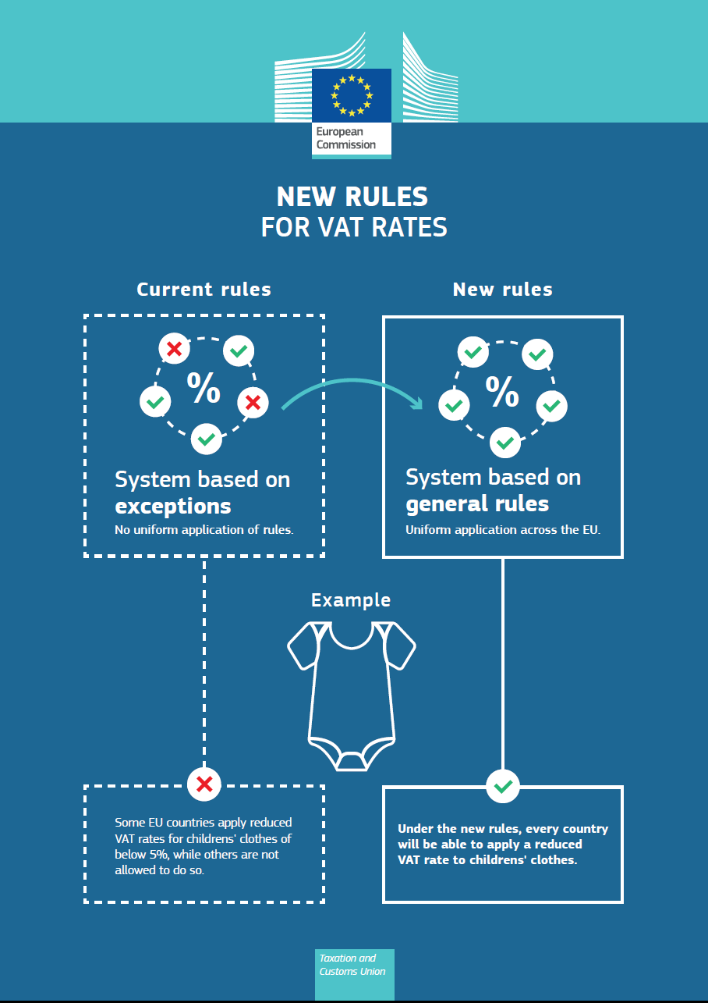

Slide 4
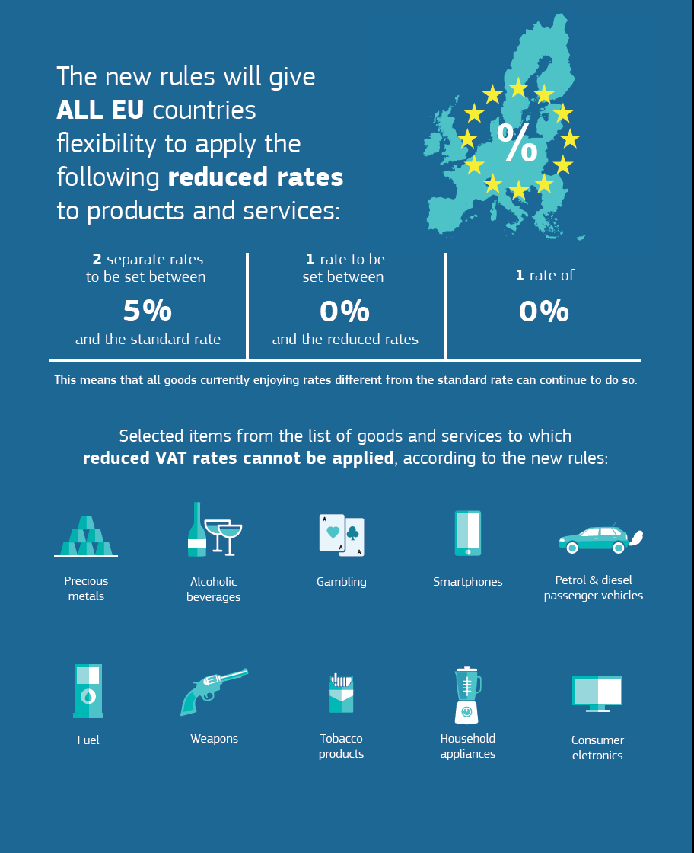

Slide 5
Geographical features of the application of VAT in the EU
DENMARK
The Faeroe Islands and Greenland are not part of the European Union;
consequently, no VAT is applied in these territories.
GERMANY
For VAT purposes, the country does not include the island of Heligoland and
the territory of Büsingen.
GREECE
According to Article 120 of the VAT Directive, Greece had a right to apply rates 30% lower than the corresponding rate applied in the mainland to the islands of Leros, Lesbos, Kos, Samos and Chios.
The lower rates applied in these Greek Islands are 4%, 9% and 17%.
The lower VAT rates will be abolished on 30.06.2018.
Mount Athos is excluded from the scope of VAT as part of the customs territory of the Community.
SPAIN
For VAT purposes, the country does not include the Canary Islands, Ceuta
and Menilla.
FRANCE
Special rates apply in Corsica and the overseas departments (DOM):
a) Corsica
0.90%: the first performances of certain shows, the sales of livestock intended for use as foodstuff
to persons/entities not liable to pay tax;
2.10%: some goods supplied in Corsica and some services to which the
reduced rates are applicable in mainland France;

Slide 6
The standard rate applicable in Corsica is the same as
in the rest of the country: 20%.
b) DOM
In the overseas departments, but not French Guiana and Mayotte,
a reduced rate of 2.10% and a standard rate of 8.5% are applicable; the
rates of 1.05 % and 1.75 % are also applicable respectively to the press
and the first performances of certain shows, and to certain sales of animals for slaughter.
c) Monaco
Goods and services supplied to or from the Principality of Monaco are
regarded as having been supplied to or from France.
ITALY
The following territories are excluded from the scope of VAT: Livigno,
Campione d’Italia and the territorial waters of Lake Lugano.
CYPRUS
Transactions originating in, or intended for, the United Kingdom Sovereign
Base Areas of Akrotiri and Dhekelia are treated as transactions originating in,or intended for, the Republic of Cyprus.
AUSTRIA
A special rate of 19% applies in Jungholz and Mittelberg.
PORTUGAL
Special rates apply in the Autonomous regions of Azores and Madeira:
a) In the Azores 4%: reduced rate; 9%: reduced rate / parking rate; 18%: standard rate;
b) In Madeira 5%: reduced rate;12%: reduced rate / parking rate; 22%: standard rate.

Slide 7
AUSTRIA
A special rate of 19% applies in Jungholz and Mittelberg.
PORTUGAL
Special rates apply in the Autonomous regions of Azores and Madeira:
a) In the Azores
4%: reduced rate;
9%: reduced rate / parking rate;
18%: standard rate;
b) In Madeira
5%: reduced rate;
12%: reduced rate / parking rate;
22%: standard rate.
FINLAND
The Åland Islands are excluded from the scope of VAT.
UNITED KINGDOM
Goods and services supplied to or from the Isle of Man are regarded as having been supplied to or from the United Kingdom.

Slide 8
INSULEUR’s Position
INSULEUR would like to keep intact the content of the article 120 and of all other provisions on reduced VAT in islands and extent expressis verbis this regime of reduced VAT rates to all European Islands.
INSULEUR supports the possibility of Governments of Member States willing to apply reduced VAT to their islands to do this. This will give a level playing field to insular companies, principle of high value for the European Commission, for their competitiveness and best prices for insular habitants.
.

