Slide 1
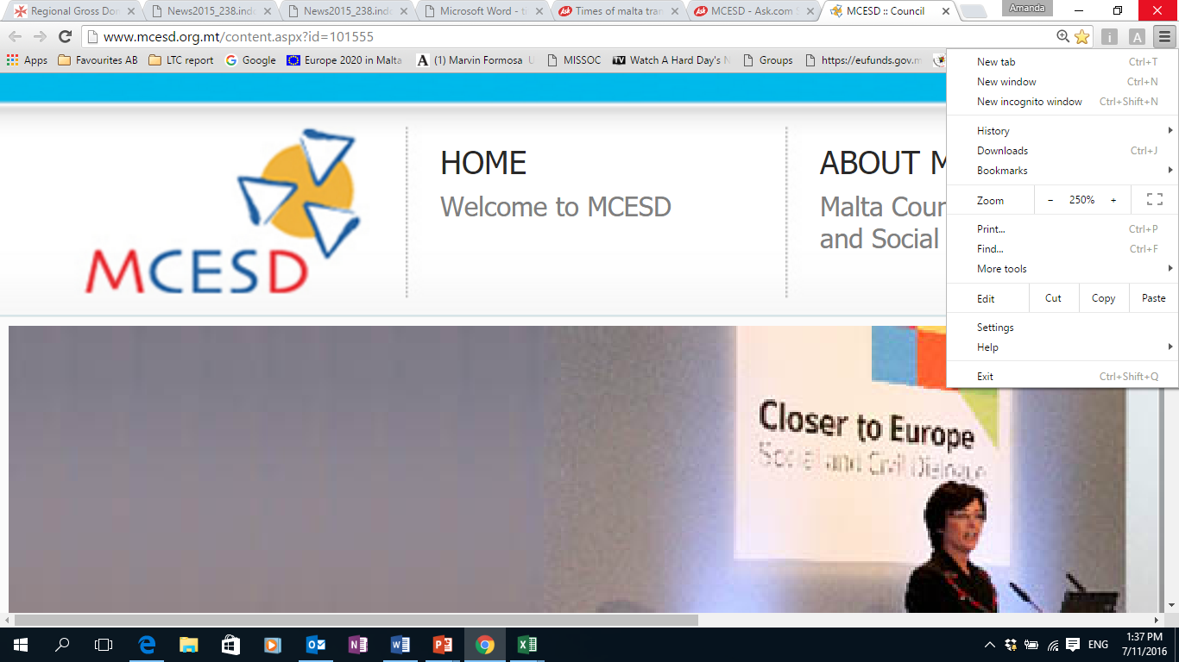
Sustainable Mobility and Tourism as Drivers for Economic Growth in European Islands
Ms. Sylvia Gauci
Executive Secretary, Malta Council for Economic Social Development (MCESD)

Slide 2
Drivers for sustainable Mobility
Transport is essential as it facilitates movement but its excessive growth is becoming a detriment to the environment and quality of life.
Focus has shifted towards transportation that:
  respects safety and the environment,
  ensures the provision of life’s material needs, and
  guarantees fairness among individuals.
Transport is responsible for 23% of global energy-related GHG emissions

Slide 3
Drivers for sustainable Mobility
Malta is currently characterized by a high level of private car ownership moving parallel with population growth and rise in economic activity which generates movement.
These factors are putting substantial strain on the sustainability level of transport on the Maltese Islands.
Malta ranks second for the highest number of cars per inhabitant in the EU.
The cost from transport was estimated at €274 million in 2012 and is expected to increase further if effective measures are not undertaken.

Slide 4
Malta’s initiatives for Sustainable Mobility
Most of the initiatives are designed at local level.
The scope is to reach individuals easier and therefore be more effective with the objective that its effectiveness at local level will elevate at national level.
All these measures and initiatives will be promoted though Information and Awareness Raising Campaign.

Slide 5
Challenges for implementation
Like any other Island Malta face a number of challenges on different fronts.
    Energy use
    Space use
    Road safety
    Air quality and noise pollution
    High pressure from tourism
    Seasonal fluctuation
    Capacity of resources
    Behavioural changes
For measures to be effective, the public needs to be motivated to change to alternative mode of transport, incentivising behavioural change.

Slide 6
Challenges for implementation
Productivity: Unsustainable transport can impinge on productivity. A study between the UOM and the EC has estimated that commuters lose 52 hours per year and the cost of making business has increased by €32.4 million.
Tourism: Rather than facilitating movement this situation is immobilising people which could negatively affect tourism.
Quality of Life: Congestion and emissions are increasing stress and increasing health issues as a result of the negative impact on the environment which is also aesthetically unpleasant.

Slide 7
Conclusion
The higher the economic growth, the higher the expected movement of people and commodities.
sustainable mobility is crucial and it is at the heart of sustainable economic growth.
These measures are aimed towards a more efficient and maintainable transport network.
The process undertaken is one where one measure does not fit all.
Thus, initiatives are taken at local level to address specific issue relative to that locality which all together address a major national challenge.

