Slide 1
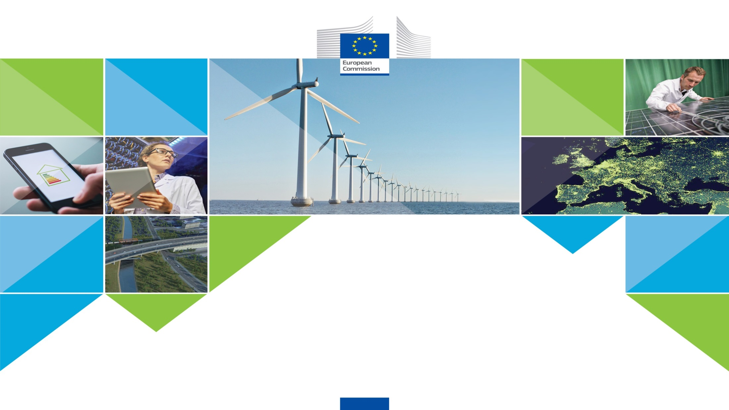
CLEAN ENERGY FOR EU ISLANDS
Brendan Devlin
European Commission – DG ENERGY

Slide 2
2.700 islands in the EU, population nearly 15 million
Today
High costs for electricity production
Compensation of these high cost: over 3 billion EURO annually
Looking ahead
Bring down energy production costs
Eliminate subsidies for fossil fuels
Focus on energy efficiency and renewables, with best use of available technologies
Dependence on fossil fuel
Notes:
Islands have many opportunities, but do in fact also face several challenges when it comes to energy
Firstly, the majority of EU islands use diesel generators for electricity, and these generators emit a lot of CO2 and harmful particulates.
Many islands suffer higher costs for this energy supply due to their isolation and small size; bringing hydrocarbon fuels for electricity and transport to these islands costs money, and exposes islands to global market price fluctuations they can't influence.
Electricity prices on near shore non-interconnected small islands are 3 times more expensive than onshore.
Secondly, keeping energy prices paid by consumers on islands near the prices charged on the mainland means ‘subsidizing fossil fuels’. For example, public service obligations to level the energy prices for Greek consumers on islands ranged up to 600 Million EURO annually in 2015 and the compensation for EU islands amounts to over EUR 3 billion annually. That is a huge sum that can be better used.
If the islanders’ businesses and households were not subsidised, then they would face even greater challenges to their competitiveness and affordability.
These subsidies are a long-term drain on central government funds, and are inappropriate as Europe moves towards Clean Energy for All Europeans.
Thirdly, many islands do not have much space, and because several are unique ecosystems the space is protected – Therefore, the idea to cover sunny islands with photo-voltaic panels for the energy transitions is too simplistic.
Looking Ahead
(1) Bringing the production costs and prices for island consumers in line with European best practice;
(2) Eliminating subsidies for fossil fuels; and
(3) Delivering best available technologies to islands, with a focus on energy efficiency and renewables.
The actors will be islanders, enabled by the Commission. That is why the top-down approach that we can provide should be matched by a bottom up response from islands and islanders.

Slide 3
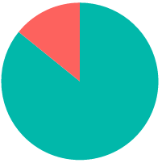
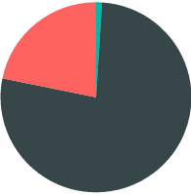
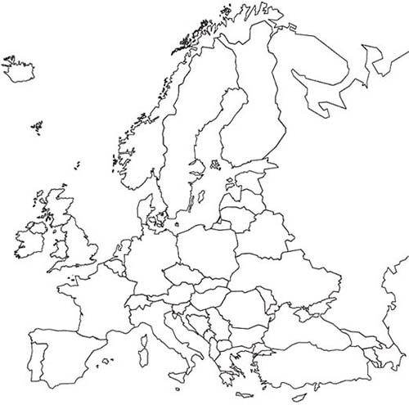
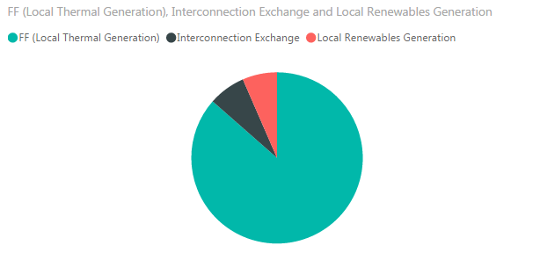
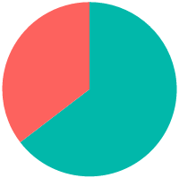
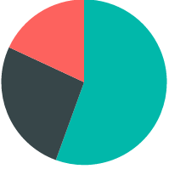
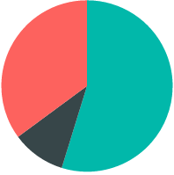
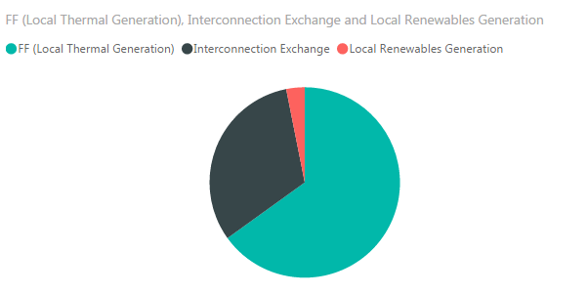
TODAYS ENERGY MIX ON A SAMPLE OF ISLANDS
1.
Greek islands
4.
Aland
4
2.
Spanish islands
6
5.
Azores
2
3
1
5
3.
Italian islands
6.
Swedish islands
Local Fossil Generation
Notes:
So where are we today?
Showcase of the energy mix on a sample of islands.
Greek non-interconnected islands
Balearic and Canary islands, Spain
Sardinia, Sicily and small Italian islands
Aland; Finland
Azores, Portugal
Gotland, Sweden
These charts show a dominance of fossil fuel on this sample of islands and fossil fuel in this case is mainly oil and diesel fuel fired generation.
It also indicates connection capacity, or the lack thereof. However for some of these islands connecting to the grid of 'mainland' Europe is not a feasible way forward.
For example, the Azores are not only far away from Portugal, but the groups of islands in this archipelago are also dispersed over 600 km.
Disclaimer: for the Greek islands, this are ONLY the non-interconnected islands, as there is no disaggregated data available per small regions/island.

Slide 4
From Silos to…….
Jobs and Growth
Islands Decarbonisation
Skills Agenda

Slide 5
To Integrated Action
Giving Opportunities to Youth
Increasing Skills of Engineers
Planning Energy Transition

Slide 6
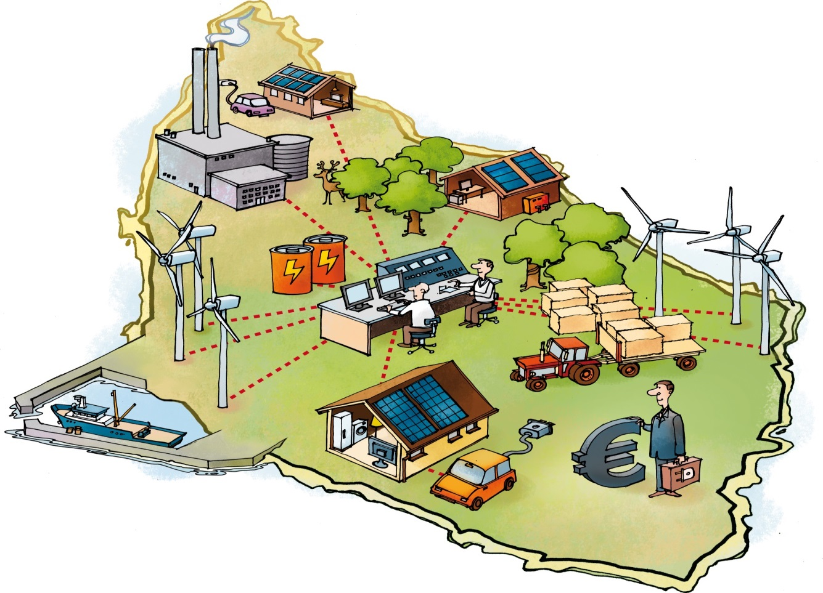
CLEAN ENERGY FOR EU ISLANDS INITIATIVE
THE INITIATIVE IS ABOUT…
ISLANDS TO CONTROL THEIR FUTURE THROUGH…
Optimally using islands' resources and infrastructures
Energy efficiency measures in buildings/industry
Mainstreaming existing instruments and best practices
Micro grids, demand-side management and storage
Spurring up investment
Variable renewable energy sources, e.g. marine energy
Transferring knowledge from one island to the other
Etc.
Illustration: EU-funded project ECO-Grid on Bornholm, DK

Slide 7
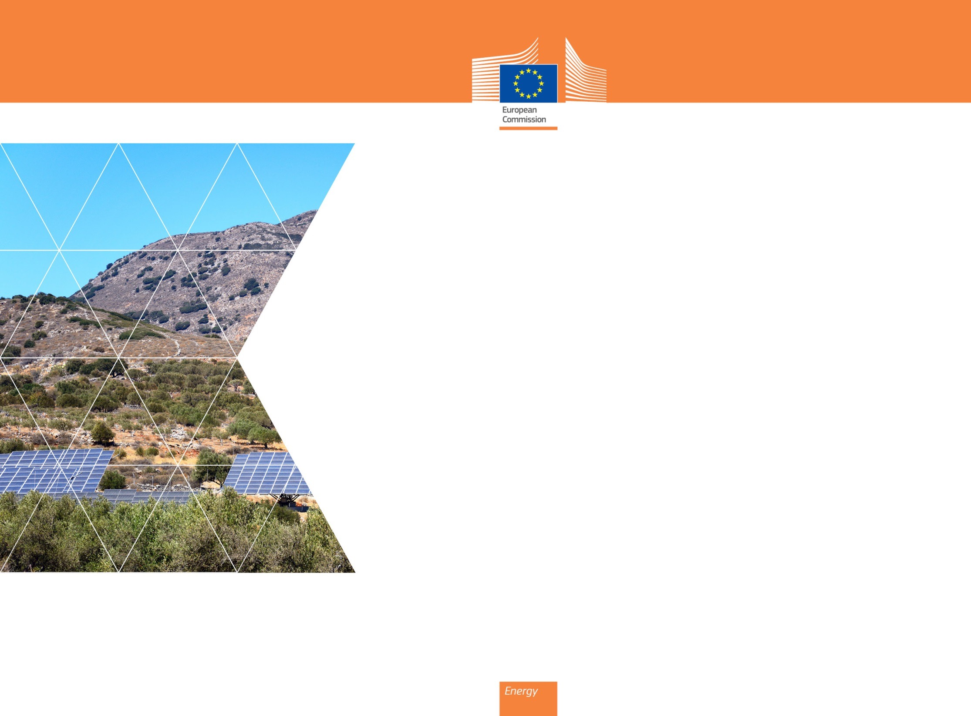
Sustainable Energy For All European Islands
As far as practically possible; self-sufficient, sustainable, local energy.
Community led for local needs.
Whole island concept, covering, electricity, heating, cooling, transport on the island and ferry services.
A high degree of local participation, local employment and community agreement
Lower costs, prices and subsidies, as referenced to the status quo ante

Slide 8
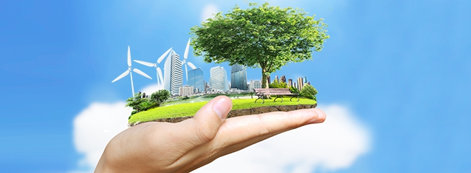
Any Questions?: brendan.devlin@ec.europa.eu
Our core values – excellence, transparency, integrity
Notes:
8

Slide 9





THE CLEAN ENERGY FOR ALL EUROPEANS PACKAGE
  Putting energy efficiency first
  Demonstrating global leadership in renewables
  Delivering a fair deal for consumers
An opportunity to..
…create jobs & growth
…make the market fit for purpose
…secure energy supply
…foster innovation
…bring down GHG emissions
…spur investment
Notes:
Opportunities
Jobs and growth
The energy sector alone employs close to 2.2 million people, spread over 90 thousand enterprises across Europe.
The package has the potential to deliver up to 900,000 additional jobs and €190 billion in GDP gains by 2030
Global clean energy transition:
Translate climate ambition into concrete climate actions
EU firms and technologies to secure a leading role in global clean energy transition
Energy security:
Fossil fuel import bill savings up to €290 billion for the 2021-2030 period compared to business as usual conditions
Internal energy market to support diversification of import sources
Consumers
Share of energy spending in low-income households spending is ~9%.
Energy efficiency measures to bring significant energy savings for all c onsumers
Energy consumers to become prosumers, to choose when and how to satisfy their energy needs
Challenges
Energy Efficiency
Need to increase rate and depth of buildings' renovation, from current 1% annual rate
EU firms and technologies to continue leading the race towards energy innovation
Renewables
EU firms and technologies to continue leading the race towards energy innovation
Electriticy markets to be made fit for renewables, and renewables fit for the markets
Deal for Consumers
Provide consumers with necessary tools to make them benefit from the energy transition: access to information, recognition of energy communities role, access to smart technologies
Ensure coherence and adequacy of policy action at various levels

Slide 10




THE ENERGY SYSTEM OF TOMORROW WILL LOOK DIFFERENT
  2015
  Most ambitious climate agreement signed in Paris, thanks to EU
  2030
  50 % of electricity to come from renewables
  2050
  Carbon free electricity &
  transport further decarbonised
CREATING JOBS AND GROWTH, REDUCING GREENHOUSE GAS EMISSIONS, SECURING ENERGY SUPPLY
  Delivering a fair deal for consumers
  Putting energy efficiency first
  Making the EU world leader in renewables
Notes:
2015 Paris climate agreement
From 2030: 50 % of electricity from renewables. Already today 90 % is connected to distribution grids.
And looking further, electricity in the EU should be carbon free by 2050.
In this context, the European commission adopted the Clean energy for all Europeans Package in November 2016. With political goals for :
Energy Efficiency;
Renewables; and
Placing the Consumer at the heart of the Energy Union
Putting energy efficiency first
Energy efficiency has a direct impact on lowering the energy bill for consumers. Changes on metering and billing for heating and cooling, and hot water supplied from collective systems, will give consumers clearer information on their energy consumed. In multi-apartment buildings alone this could trigger additional energy savings of some 8 Mtoe in 2030, which equals Croatia's primary energy consumption in 2013.
It also addresses social imbalances in energy access: the performance of buildings has a major impact on affordability of housing and on energy poverty; the efficiency improvement of the housing stock would enable many households to escape energy poverty. The proposal could contribute to take out from energy poverty between 515 thousand to 3.2 million households in the EU.
(the cursive parts are only relevant if you want to highlight elements of the package)
Improving the energy efficiency of products through Ecodesign and Energy Labelling delivers yearly energy savings equivalent to the annual energy consumption of Italy. As a result, European households can save up to €500 per year on their energy bills.
As the need to mobilise and unlock private investment is key for a successful energy efficiency policy, the European Commission is launching the Smart Finance for Smart Buildings initiative. This initiative can unlock an additional € 10 billion of public and private funds until 2020.
he European Performance of Buildings Directive review will significantly contribute to the competitiveness of European industry (mainly insulation and flat glass) by increasing their market by €23.8 billion in the EU by 2030, and creating a building renovation market for SMEs with a value of between €80-120 billion.
EU No 1 in Renewables
Europe wants to become the world number one in renewables: it has set itself a target to collectively reach a share of at least 27% renewables in the final energy consumption by 2030. It has spearheaded global efforts to fight climate change, and has been leading global efforts with a commitment to cut emissions by 40% by 2030.
According to IEA, renewable energy surpassed coal as main source of power capacity since 2014.
Yet:
investments in renewable have dropped by more than half since 2011 to 44 billion Euro last year: the EU now accounts for only 18% of global total investment in renewables, down from close to 50% only 6 years ago;
the heating and cooling, and the transport sectors continue to rely heavily on fossil energy imports.
The Directive supports the use of renewables in heating and cooling through the progressive introduction of renewables into the fuels marketed by suppliers.
The Directive proposes a continuous increase in the share of innovative renewables in transport, with specific attention to biofuels.
Delivering a fair deal for consumers:
Consumers are at the centre of the Energy Union.
In the new energy market, consumers will benefit from greater control over their energy demand and spending.
The new energy markets will deliver more innovative services and more opportunities for savings for all consumers.
Consumers can finally become active market players, aided by the growing affordability of new small scale technologies such as rooftop solar panels.
Engaged consumers who interact with the market will make the electricity system more flexible, facilitating the integration of electricity from renewable energy sources and reducing the need for costly back-up.
What changes for the consumer?
Consumers or communities of consumers will be entitled to produce, store or sell their electricity
Consumers will be able to request a smart meter from their energy supplier and benefit from market-based energy prices.
Consumers will have the option to make savings by changing their energy consumption patterns to match the true minute-by-minute costs of supplying energy to them – so-called demand response. This could even mean receiving a payment to turn down their heating system to stabilise the grid. Or it could mean access to cheaper energy via dynamic price contracts and smart meters when wind farms and solar panels produce large quantities of electricity.
Enabling the transition on islands
As part of the enabling actions linked to the Clean Energy for all Europeans proposals, an initiative for EU islands was announced in November 2016.
This initiative aims to accelerate the clean energy transition on islands to ensure that they can provide secure and clean energy and low-emission transport to their citizens – and do so at an affordable cost.

Slide 11

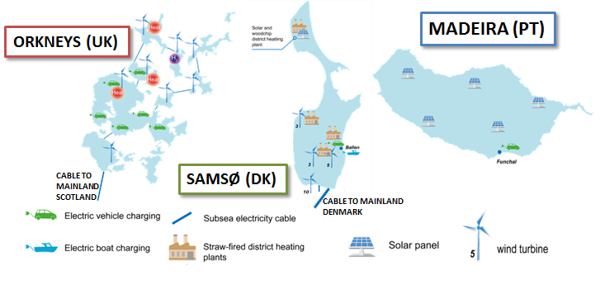
Mainstreaming existing instruments and inspiring examples
  SMart IsLands Energy systems (SMILE)
Notes:
Islands are generally well-placed to be the drivers of clean energy transition and to become energy self-sufficient.
There are several inspiring examples of islands and their local energy communities promoting energy efficiency and high shares of renewables and showing how this can be integrated into energy systems.
The Commission would like to accelerate the energy transition on islands to ensure islands provide secure and clean energy to their citizens and do so for affordable costs.
The energy transition will also aid the ambition to be number 1 in renewables and ensure jobs and growth.
Several islands are indeed already supported by the Commission, e.g.
DG ENER – HORIZON 2020
Pilot projects for islands to integrate local renewable production and storage facilities to achieve a high degree of autonomy.
this SMILE project will demonstrate different innovative technological and non-technological solutions in large-scale smart grid demonstration projects in the Orkneys, Samsø and Madeira islands, paving the way for their introduction in the market in the near future. The technological solutions focus on: the integration of battery technology, power to heat, power to fuel, Demand side management and electric transport. -EU CONTRIBUTION: €12.1 m
The new programming period already includes a call dedicated for projects on clean energy transition: 18m€
DG REGIO– clean energy for islands: 983m€
promotes the accelerated development of RES active coordination among competent Public Administration Bodies, Technology Centres and Universities of the different regions
DG MARE
Estimates that ocean energy could meet 10% of the EU's power demand by 2050.
And they commissioned a strategic roadmap for the ocean energy sector (published in 2016)
Providing an analysis of what the industry considers as necessary conditions for further development towards industrial phase in the medium term.
In 2017 ENER will launch 1,5m€ call for proposals studies & research.

Slide 12
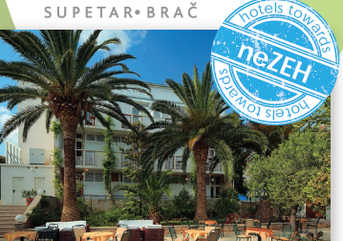
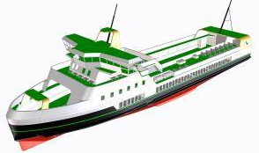
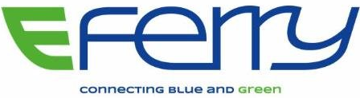
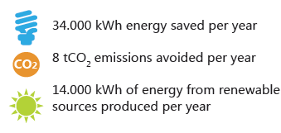
Mainstreaming existing instruments and inspiring examples
Notes:
Energy efficiency
Energy efficiency should be considered as a source of energy in itself:
It is endless
It is available everywhere, so also on islands!
The high cost for energy on islands, also mean energy efficiency measures are very attractive on islands.
Nearly Zero Energy Hotels (neZEH) scope was to accelerate the rate of large scale renovations of existing hotels into Nearly Zero Energy Buildings (NZEB) by:
providing technical advice to committed hoteliers and demonstrating the feasibility of such investments through pilot projects
undertaking training and capacity building activities
promoting front runners at national and EU/International level through integrated communication campaigns, increasing awareness of NZEB benefits and challenging more SMEs to invest in NZE refurbishment projects
These pilot projects were run across Europa and also on islands as Crete, Greece and Brač in Croatia.
Electric transport
The example of the 'Smile project' already included electric vehicle on the islands, the next step is electric transport to the islands.
The European Union has set aside EUR 16 million for the e-Ferry project run jointly by Denmark, Finland, Greece and Switzerland.
e-Ferry will build the first mid-size 100% electrically powered ferry to link Aero island to mainland in Denmark.
The ferry will be powered by wind sourced electricity and will be able to carry 130 passengers and 40 vehicles, saving 2,000 tons of CO2 per year.
The ferry will carry the largest battery pack ever installed with a high charging capacity allowing for short port stays.
Conclusion
These are just some inspiring examples of what the island communities, supported by the EU and their Member States are already working on towards cleaner energy for the EU islands.
The technology has progressed; innovation has led to energy efficiency measures in buildings and industry. Micro-grids, renewable systems supported by demand side management and storage, have been tested, and found to be stable and feasible. These technologies can be deployed on islands.
The islands will be encouraged to take control of their future; in the new energy era, consumers will be at the centre of the energy market, and Communities of consumers can create their own self-sustained energy system, deciding for themselves what is best for them.
The Commission will deliver an enabling framework for islanders to achieve clean energy with competitive pricing and costs, rolling-out established technologies and testing new ones.
We look forward to working closely with the MS concerned, island communities and financial institution in promoting the clean energy transition on islands.
Goals:
Trigger the uptake of smart technologies to ensure the optimal management and use of (the islands') resources and infrastructures
Move away from fossil fuels by tapping (the islands') significant renewables and energy efficiency potential
Introduce sustainable island mobility including electric mobility
Diversify (the islands') economies by exploiting the intrinsic characteristics of (the islands') to create new and innovative jobs locally
Strengthen social inclusion, education and citizens’ empowerment

