Slide 1




Slide 2

ENERGY UNION AND SMART ISLANDS
A Public Hearing organized by the Network of the Insular Chambers of Commerce and Industry of the EU (INSULEUR)
In collaboration with the Islands Commission of the Conference of Peripheral Maritime Regions (CPMR) and the European Small Islands Federation (ESIN)
Friday 10th of July 2015
European Economic and Social Committee (EESC)
Brussels,
Rue Belliard 99 (Room JDE 70)
Mr. George ASONITIS
Representing FIREMED Partnership

Slide 3

FIREMED in short
Full title: Innovative Financial instruments to support energy sector SMEs in Med Area
Acronym: FIREMED
Starting date: 01/05/2013
Closure date: 30/06/2015
Duration: 26 month
Overall budget allocated: 1.919.181 (ERDF: 1465.181,78)
Project areas considered: Veneto and Lombardia (Italy); Rhone-Alpes and PACA (France); Slovenia; Cyprus; Cyclades Islands and Peloponnese (Greece); Andalusian and Valencia regions (Spain); Istria (Croatia); Total regions: 11.
Lead Partner: Veneto Region – Research and Innovation Dept.
Project Partners: 14 (13 ERDF Partners and 1 IPA Partners)
Observers: 5 (4 Italy; 1 France)

Slide 4
OBJECTIVE
to strengthen the position of SMEs in the energy sector in Mediterranean regions and to increase their potential at transnational level by offering them new financial instruments to support technological and non- technological innovation.
The aim is twofold:
To assist public and intermediary bodies to develop sustainable development plans which might involve private capital and through new financial tools to support SMEs and small renewable energy and efficiency investments;
To support partners to improve the quality of the assistance to SMEs with 5 innovative services

Slide 5
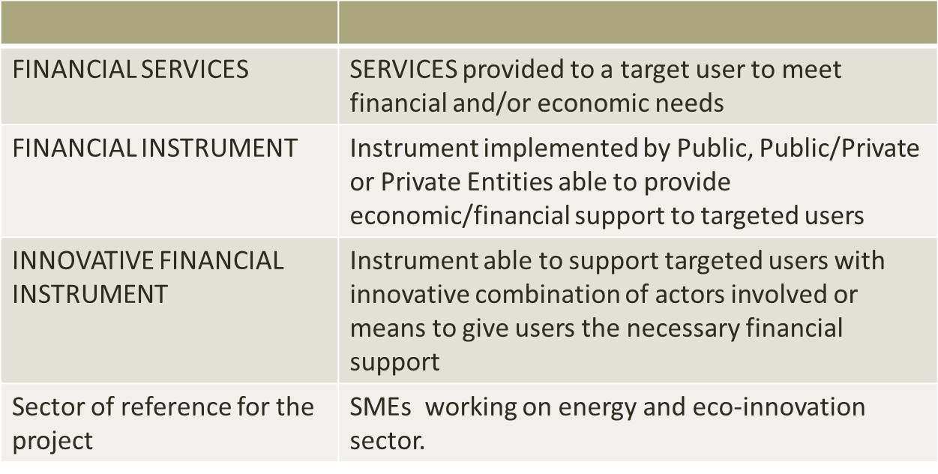
Basic concepts of FIREMED

Slide 6
FIREMED logical framework
Support to start-ups of the sectors selected
EU alert system; with Financial Instruments
Working groups with F.O. – increase knowledge on the sector
Energy SMEs in
MED area
FINANCIAL operators in MED area(and beyond)
MATCHING
Feasibilities studies for Innovative Financial Instruments
Support to established SMEs
Matching events

Slide 7
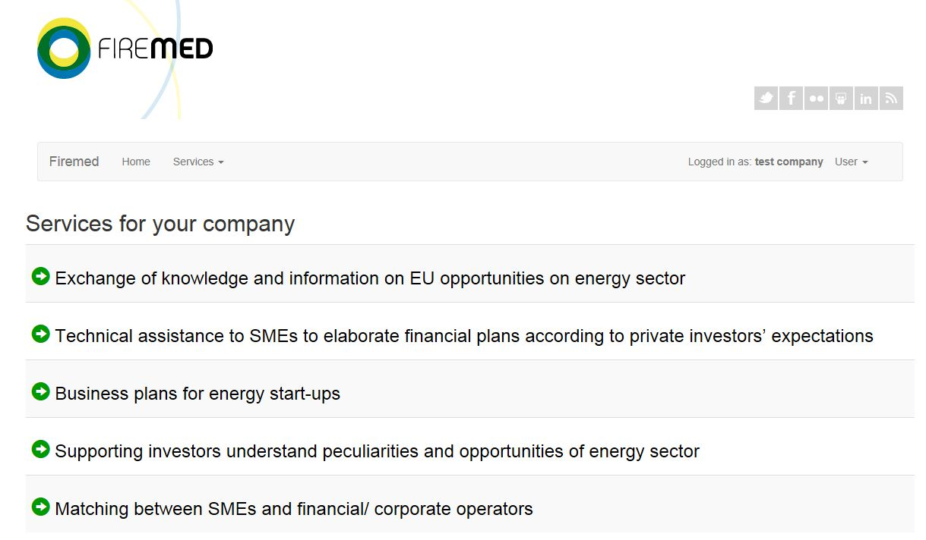
5 innovative services to assist SMEs (Phase 3.3)

Slide 8
…for more information and assistance… IT Platform (1)
www.support2finance.eu/

Slide 9
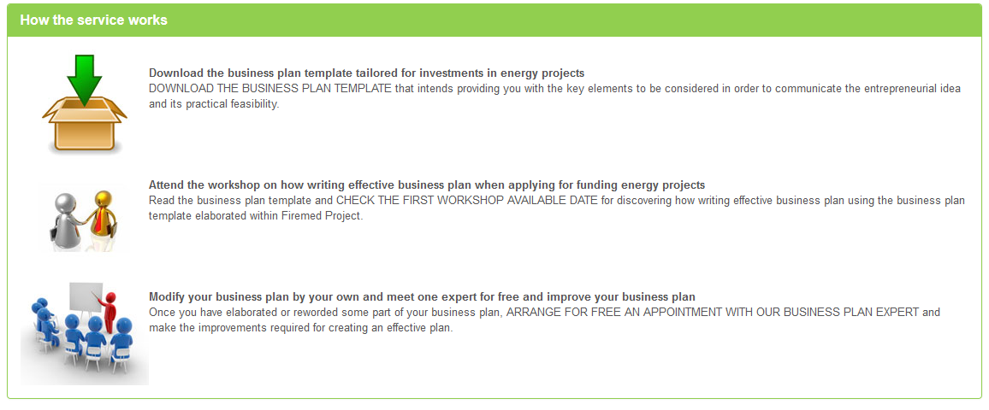
IT Platform (2)

Slide 10
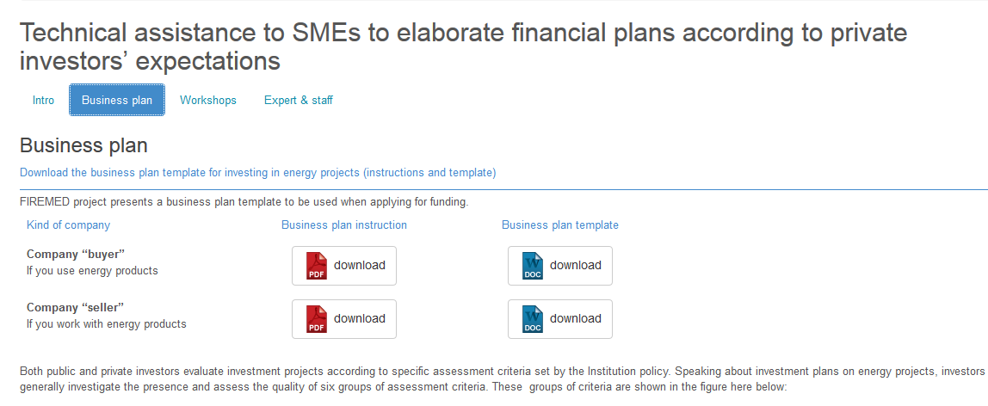

Slide 11
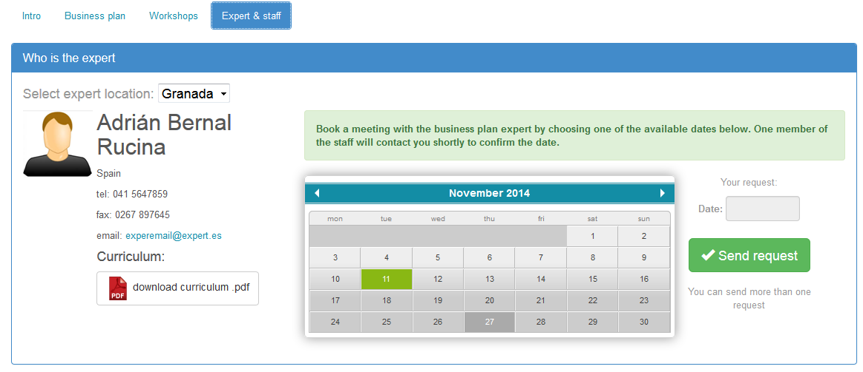

Slide 12
THE INSTRUMENTS
Identification of innovative financial instruments to support energy sector SMEs
Implementation of service and tools
Elaboration of feasibility studies on innovative financial instruments
Piloting phase

Slide 13
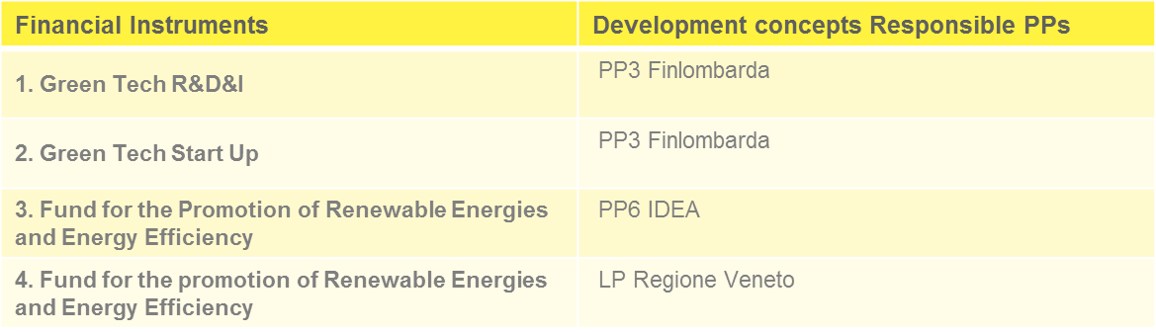
…3 financial schemes for the development of Innovative Financial Instruments…
Elaboration of Feasibility studies to improve selected instruments

Slide 14
COMP 5 – Piloting Phase and sustainability activities
Selection of SMEs and LRAs for the implementation of the piloting phase
Implementation of the 10 pilot actions on services and financial instruments
Monitoring and evaluation of the pilot actions
Development of local sustainability plans
Organized two Evaluation Committee Meetings
  Brussels, 23rd of March 2015
  Venice, 20th of May 2015
Experts from all project areas (CY, ES, FR, GR, IT, SI) to evaluate PA and prepare a list of recommendations and
Elaboration of two monitoring report on Pilot actions to be submitted to the Evaluation Commitee
  Mid - Term Report
  Final Report

Slide 15

For more information
Project Lead Partner
Veneto Region – Research and Innovation Dept.
Fondamenta Santa Lucia – Cannaregio 23
30121 - Venice (Italy) ricercainnovazione@regione.veneto.it
+39 041 2794268-4273
Project website http://www.firemed-project.eu/

