Slide 1
European Cohesion Policy 2014-2020 closely linked with EU2020
13th Insuleur Forum -
Malta 8 November 2013
M Haapakka
DG Regional and Urban Policy, EU Commission

Slide 2

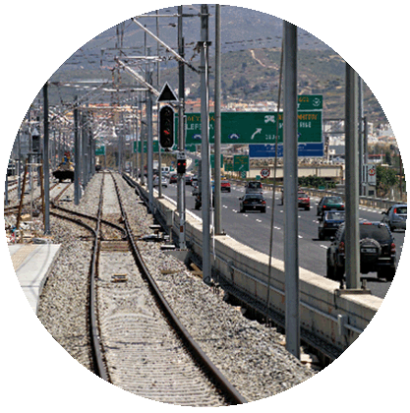


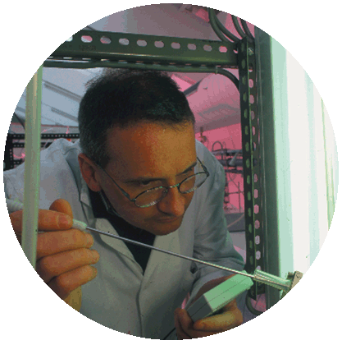
EU Cohesion Policy invests in …
SME competitiveness
Social Inclusion
Employment
Sustainable urban
development
Energy efficiency & renewable energies
Low carbon economy
Transport
Environment
Cooperation
between MS, regions and cities
ICT
Research
and innovation
Notes:
2

Slide 3
Europe 2020 – Strategy for smart, sustainable and inclusive growth
5 targets
Employment - 75 % of the population aged 20-64 to be employed
Innovation - 3% of the EU's GDP to be invested in R&D and Innovation
Climate change
  greenhouse gas emissions 20% lower than 1990 (or even 30%, if the conditions are right)
  20% of energy from renewables
  20% increase in energy efficiency
Education
  reducing the rates of early school leaving below 10%
  at least 40% of 30-34–year-olds completing third level education
Fighting Poverty and Social Exclusion - at least 20 million fewer people in or at risk of poverty and social exclusion
Flagship initiatives to boost investments

Slide 4
Cohesion Policy 2014-2020 - objectives
Deliver the Europe 2020 strategy objectives of smart, sustainable and inclusive growth
  Cohesion Policy provides the necessary investment framework and delivery system
Focus on results
Maximise the impact of EU funding
A stronger territorial approach
The European Regional Development Fund, European Social Fund and Cohesion Fund together account for more than one third of the EU's overall budget

Slide 5
Cohesion policy alignment to Europe 2020
European Structural and Investment Funds: three funds under Cohesion policy (ERDF – ESF – CF) and the Rural Development and Fisheries funds (EAFRD, EMFF)
Common Provisions Regulation (CPR) provides for
  Partnership Agreement at national level, in dialogue with the Commission
  Alignment to EU2020 through 11 Thematic Objectives (TOs)
Fund specific regulations translate TOs into fund specific priorities and define concentration of resources on themes.
COM position papers, country specific recommendations

Slide 6
Thematic objectives 2014-2020 (1)
01 Strengthening research, technological development and innovation
02 Enhancing access to, and use and quality of, information and communication technologies
03 Enhancing the competitiveness of small and medium-sized enterprises, the agricultural sector
04 Supporting the shift towards a low-carbon economy in all sectors
05 Promoting climate change adaptation, risk prevention and management
06 Preserving and protecting the environment and promoting resource efficiency
07 Promoting sustainable transport and removing bottlenecks in key network infrastructures

Slide 7
Thematic objectives 2014-2020 (2)
08 Promoting sustainable and quality employment and supporting labour mobility
09 Promoting social inclusion and combating poverty and any discrimination
010 Investing in education, training and vocational training for skills and lifelong learning
011 Enhancing institutional capacity of public authorities and stakeholders and an efficient public administration
(012) Technical Assistance

Slide 8
Cohesion Policy 2014-2020 - targeting
  Investing in all EU regions: Less developed regions (< 75% of EU-27 GDP); Transition regions (75% to 90% of EU GDP); More developed regions (GDP > 90% of EU GDP)
  ERDF concentrating on
    Innovation and research, the digital agenda, support for small and medium sized businesses (SMEs) and the low-carbon economy (Less developed regions: 50%, Transition regions: 60%, and More developed regions: 80%).
    Low-carbon economy (energy efficiency and renewables) obligations for minimum share of ERDF (Less developed regions: 12%, Transition regions: 15% and More developed regions: 20%).
    Earmarking 5 % minimum amount under the ERDF to be spent for integrated urban actions
  ESF minimum share: At least 23.1% of Cohesion policy budget will be allocated to investments under the European Social Fund (ESF).

Slide 9
Thematic
dimension:
Concentration on Europe 2020 priorities
Smart growth
Research &
Innovation
IT
SME
Sustainable growth
Low-carbon
Resource-efficient
Risk-prevention
Transport
Inclusive growth
Employment
Social inclusion
Education
Territorial
dimension:
Territorial instruments
Integrated strategies and actions
Cities and towns
I
TI
CLLD
Deprived urban neighbourhoods
Functional urban areas, metropolitan regions
Territorial pacts and local initiatives for employment, education and social inclusion
Rural areas, fisheries areas, etc.
Other functional economic areas

Slide 10
2014-2020 - Reinforced territorial approach
The Common Strategic Framework identifies:
  key territorial challenges (urban, rural, coastal and areas with particular features etc.)
  priority areas for cooperation, including macro-regional and sea basin strategies
  coordination mechanisms among the ESIF funds and with other relevant Union policies and instruments
  More detailed mechanisms and arrangements by the Member States and regions should be set out in Partnership Agreement and programmes.

Slide 11
Sustainable urban development
Min. 5% of ERDF resources in each Member State based on integrated urban strategies in line with ERDF Art. 7
At least selection of projects should be delegated to urban authorities
To be implemented with integrated approach and involvement of cities, possibility to choose among three delivery mechanisms:
  ITI
  Specific operational programme
  Dedicated priority axis

Slide 12
Article 10 of the European Regional Development Fund (ERDF)
Operational programmes co-financed by ERDF covering areas with severe and permanent handicaps:
  Island Member States eligible under Cohesion Fund, and other islands except those on which the capital of a Member State is situated or which have a fixed link to the mainland
  Mountainous areas as defined by the national legislation of the Member State
  Sparsely (less than 50 inhabitants per square kilometre) and very sparsely (less than 8 inhabitants per square kilometre) populated areas
  shall pay particular attention to addressing the specific difficulties of those areas.

Slide 13
Outermost regions
Extra allocation for the outermost (and sparsely populated) regions
ERDF Art. 11 on the use of the allocation
  not subject to thematic concentration
  shall be used to offset the additional costs linked to characteristics and constraints referred to in Art. 349 of the Treaty

Slide 14
Islands – derogation under thematic concentration
ERDF Art. 4 Thematic concentration:
All NUTS2 level regions consisting solely of island Member States or islands which are situated in Member States receiving Cohesion Fund support, or which are outermost regions, shall be considered as less developed regions for the purposes of this Article:
  Concentration: at least 50 % to innovation, ICT, SMEs and low carbon economy
  12 % to low carbon economy (if eligible to Cohesion Fund support, will increase the requirement from 12 to 15 %)

Slide 15
Tools for territorial development (1)
Integrated territorial investment (ITI) to “bundle” investments under more than one priority axis of one or several programmes to ensure integrated approach
  option for ERDF, ESF, Cohesion Fund - EAFRD and EMFF can contribute (eg. urban-rural linkages)
  integrated territorial strategies
Community-led local development (CLLD) – joint initiative of four EU funds to support implementation of joint bottom-up local development strategies (based on "Leader" approach)
  option for ERDF, ESF, EMFF, compulsory for EAFRD

Slide 16
Tools for territorial development (2)
Possibility to modulate EU co-financing rate to programme priority axis, to take account of areas with severe and permanent natural or demographic handicaps (Art. 111 CPR)
  including island Member states eligible under the Cohesion Fund, and other islands except those on which the capital of a Member State is situated or which has a fixed link to the mainland
  mountainous areas as defined by the national legislation of the Member State
  sparsely populated areas.

Slide 17
Example of ITI
Regional
ERDF-ESF OP
National/sectoral
ERDF OP
ESF OP
Intermediary
body
I
T
I
CF OP

Slide 18
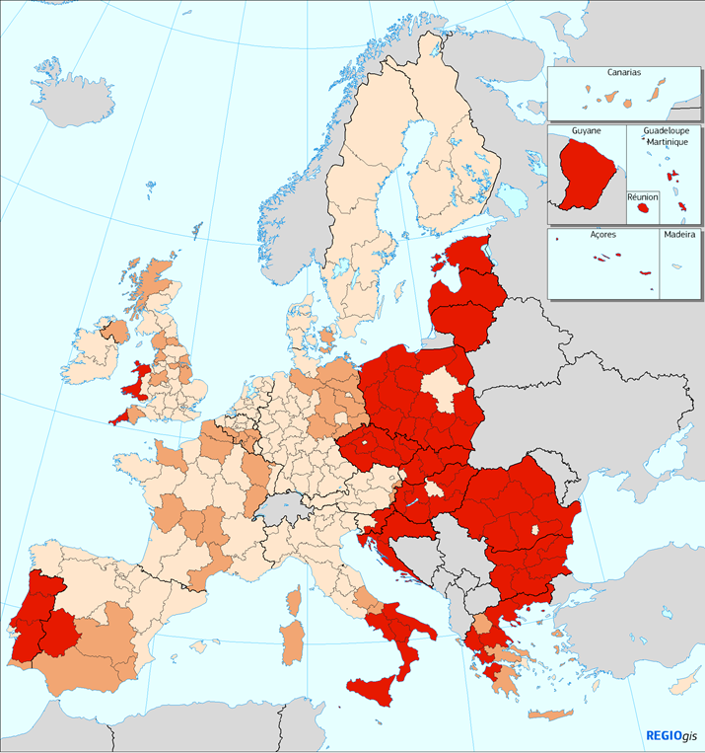
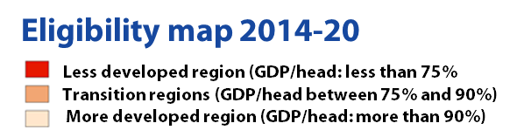
Geographical eligibility for Structural Funds support 2014-2020

Slide 19
For more information
InfoRegio: ec.europa.eu/inforegio
RegioNetwork: www.regionetwork2020.eu
http://ec.europa.eu/regional_policy/index_en.cfm
http://ec.europa.eu/regional_policy/what/future/index_en.cfm
http://ec.europa.eu/regional_policy/impact/index_en.cfm
http://ec.europa.eu/europe2020/index_en.htm

